Slide 1
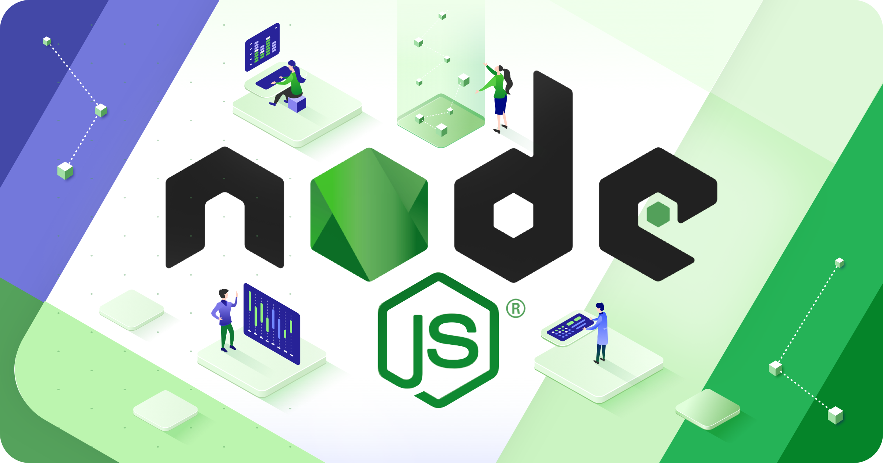

Slide 2
About Today…
Runtime Environment
Core Modules
Practical Activity

Slide 3
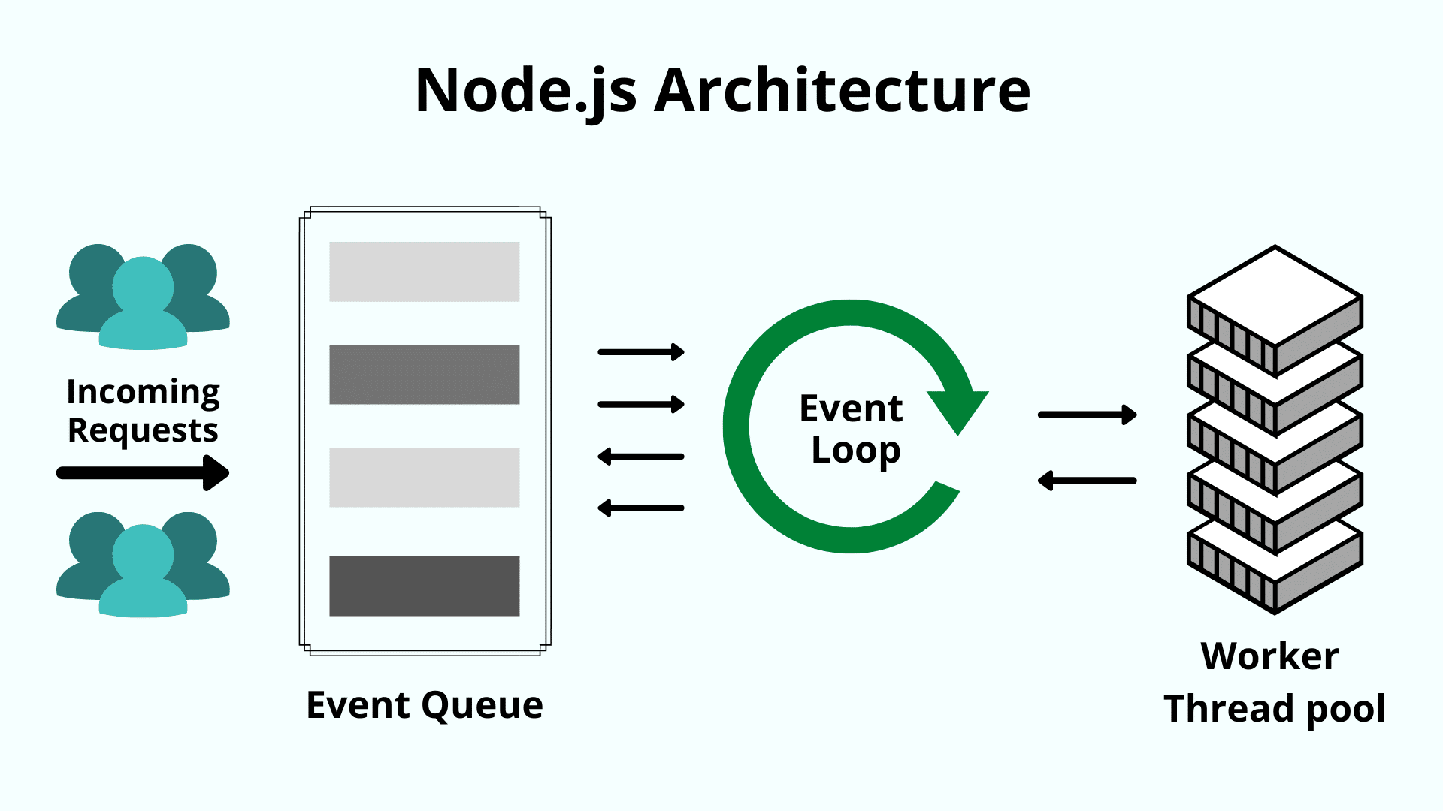

Slide 4
Node.js Runtime Environment
Single-threaded, event-driven architecture
Operates on a single thread
Utilizes an event-driven, non-blocking I/O model
Handle many connections simultaneously
Efficient and suitable for real-time applications
Non-blocking I/O model
Operations like reading a file, making HTTP requests, or interacting with a database do not block the execution of the program
Uses callbacks, promises, or async/await to handle these operations asynchronously

Slide 5
Intro to Core Modules
Built-in modules in Node.js
Provide essential functionalities for various tasks, including data handling
Key Core Modules for Data Handling
fs (File System)
Reading, writing, and manipulating files
http (HTTP)
Creating HTTP servers, handling HTTP requests and responses
path
Working with file paths and directories
events
Event handling for asynchronous operations

Slide 6
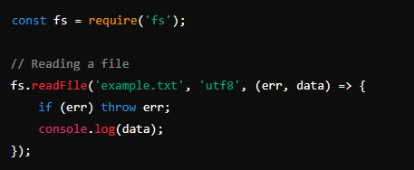
fs (File System)
Provides an API for interacting with the file system

Slide 7
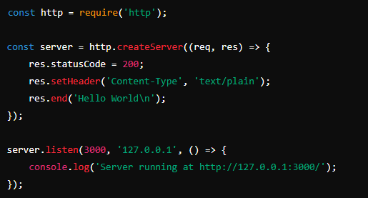
http
Used to create HTTP servers and make HTTP requests

Slide 8
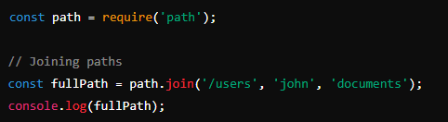
path
Provides utilities for working with file and directory paths

Slide 9
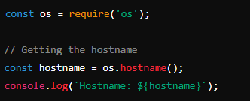
os
Provides information about the operating system

Slide 10
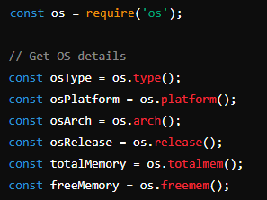
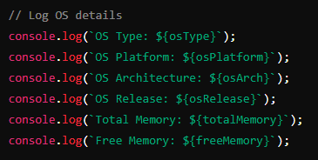
Practical Activity
Task
Use the os module to get information about the operating system

